Slide 1
Azure App Service
Lecturer: Ngo Huy Bien
Software Engineering Department
Faculty of Information Technology
VNUHCM - University of Science
Ho Chi Minh City, Vietnam
nhbien@fit.hcmus.edu.vn

Slide 2

Objectives
To deploy a PHP web app to Azure App Service.

Slide 3

Contents

Slide 4

References

Slide 5
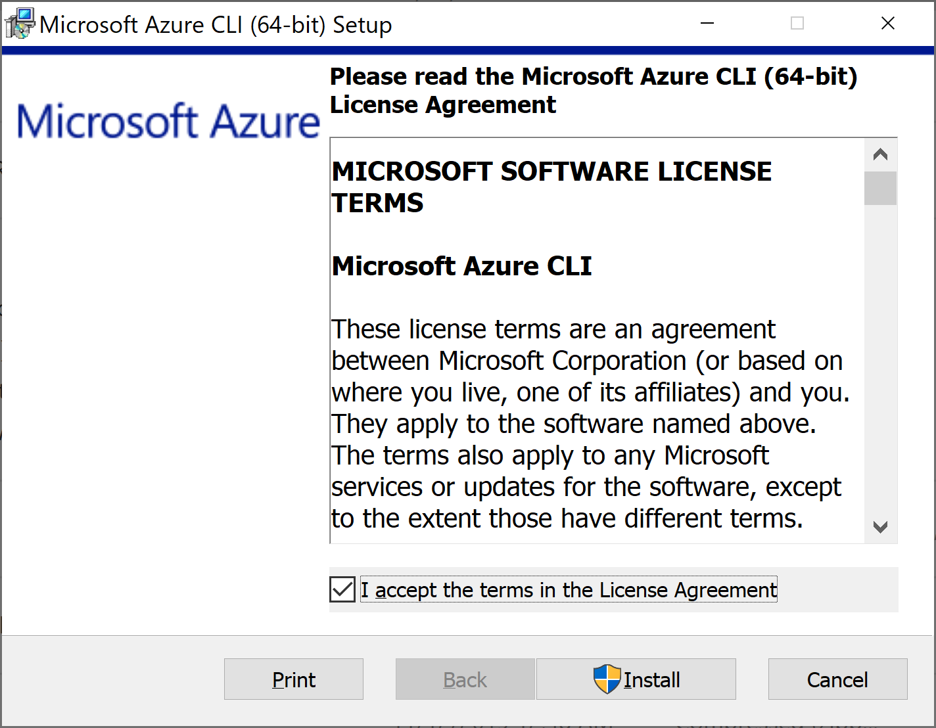
1. Install Azure CLI on Windows
https://learn.microsoft.com/en-us/cli/azure/install-azure-cli-windows

Slide 6
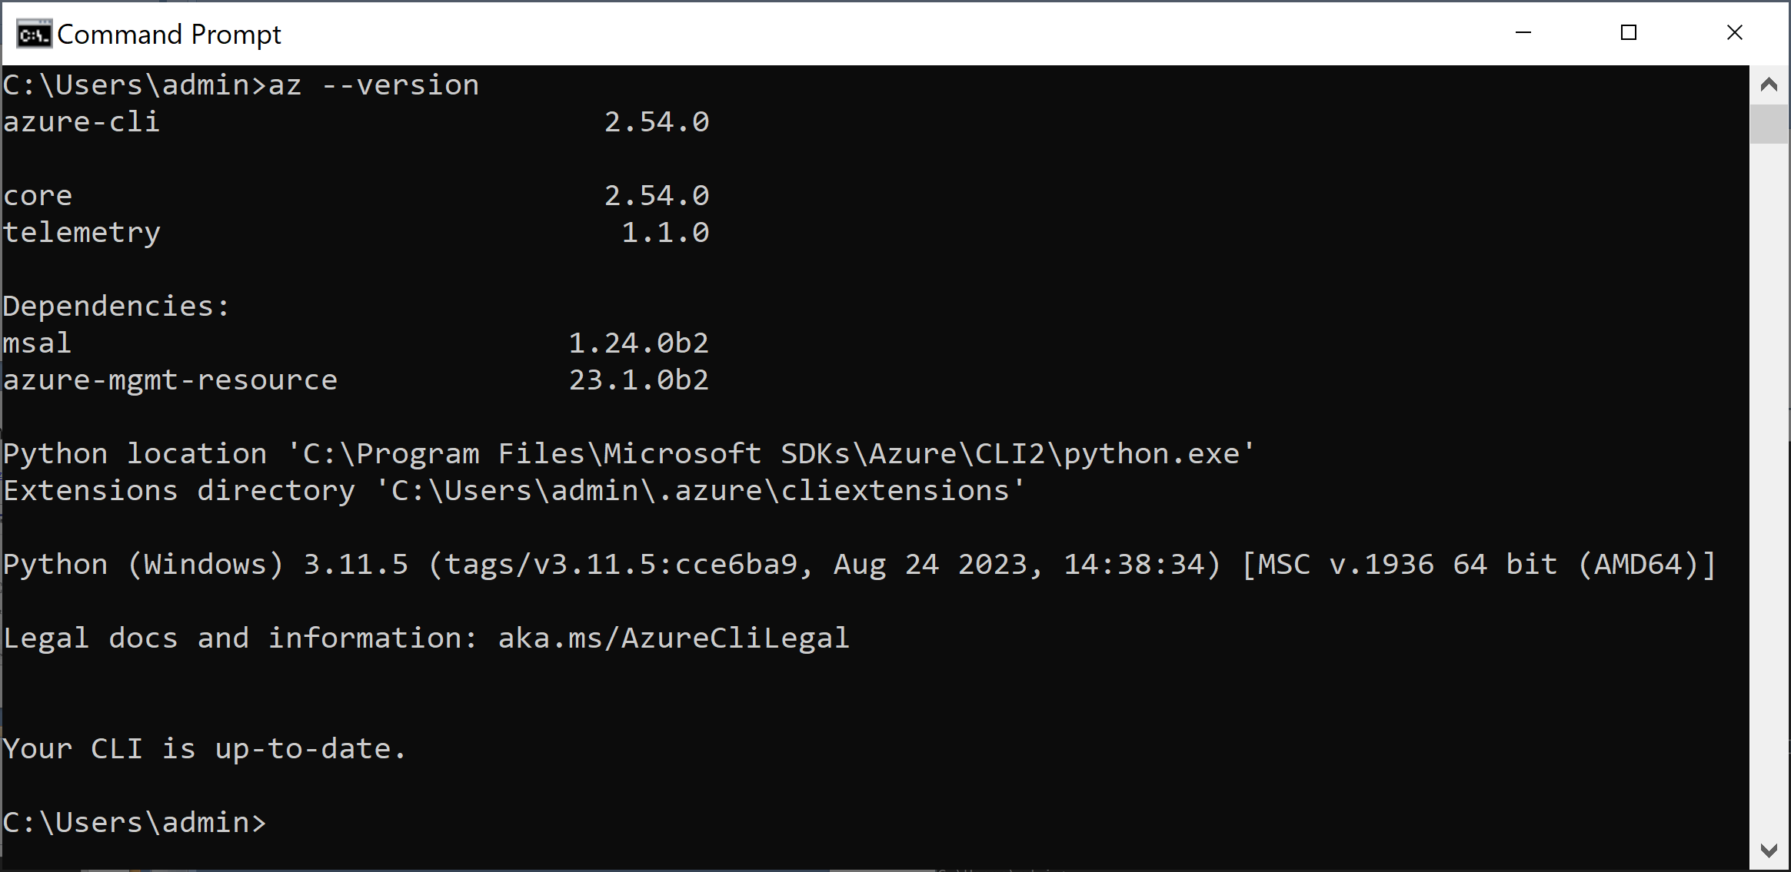
2. Verify CLI Installation
az --version

Slide 7
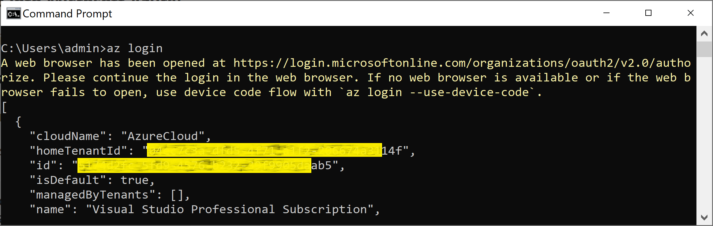
3. Log in Azure
az login

Slide 8
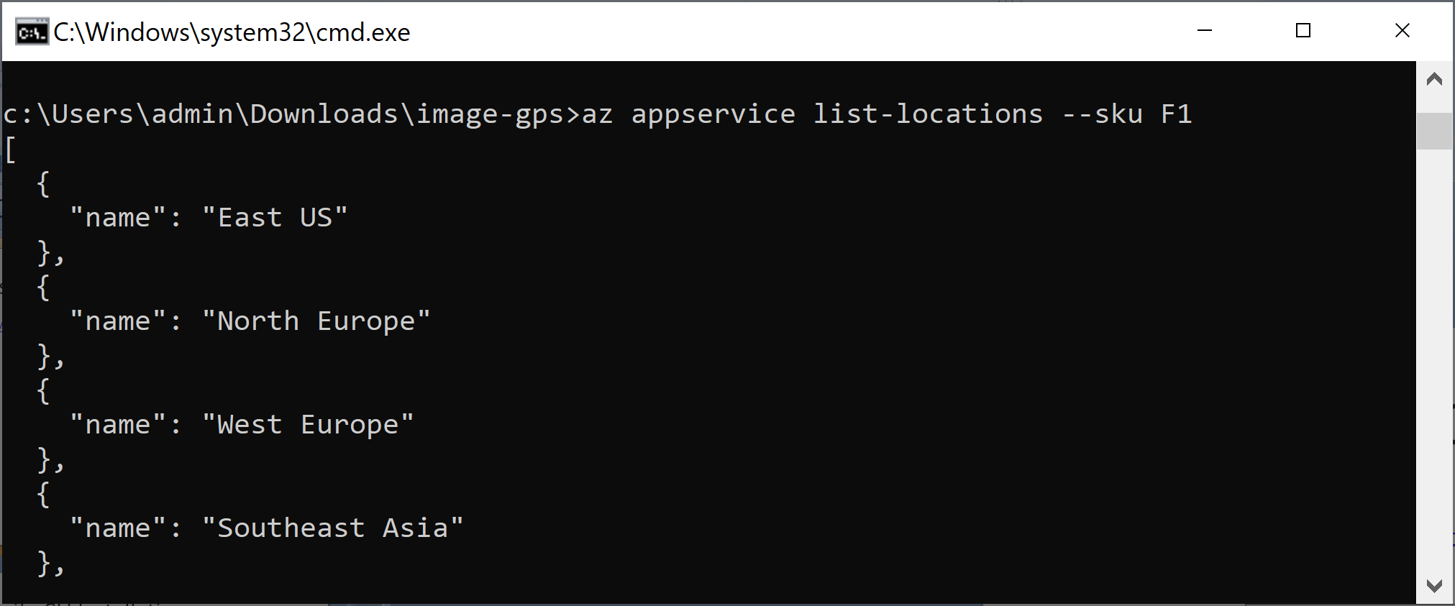
4. List Locations
az appservice list-locations --sku F1
// F1 = Free

Slide 9
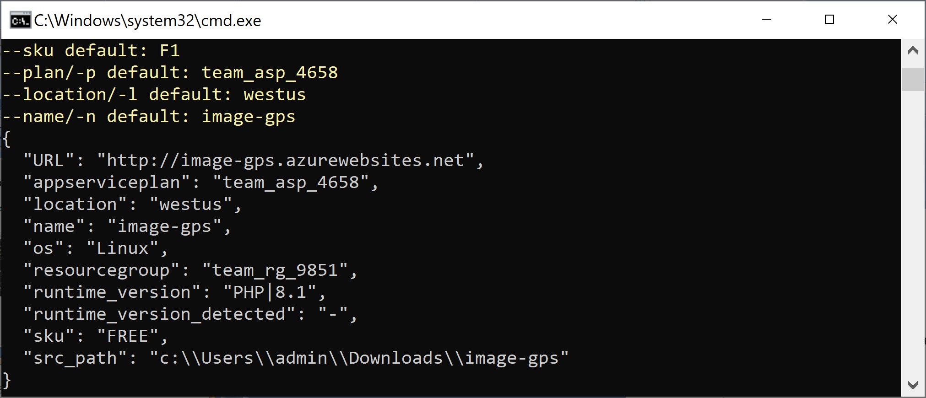
5. Deploy PHP Application
az webapp up --runtime "PHP:8.2" --os-type=linux --name "image-gps" --location "West US"

Slide 10
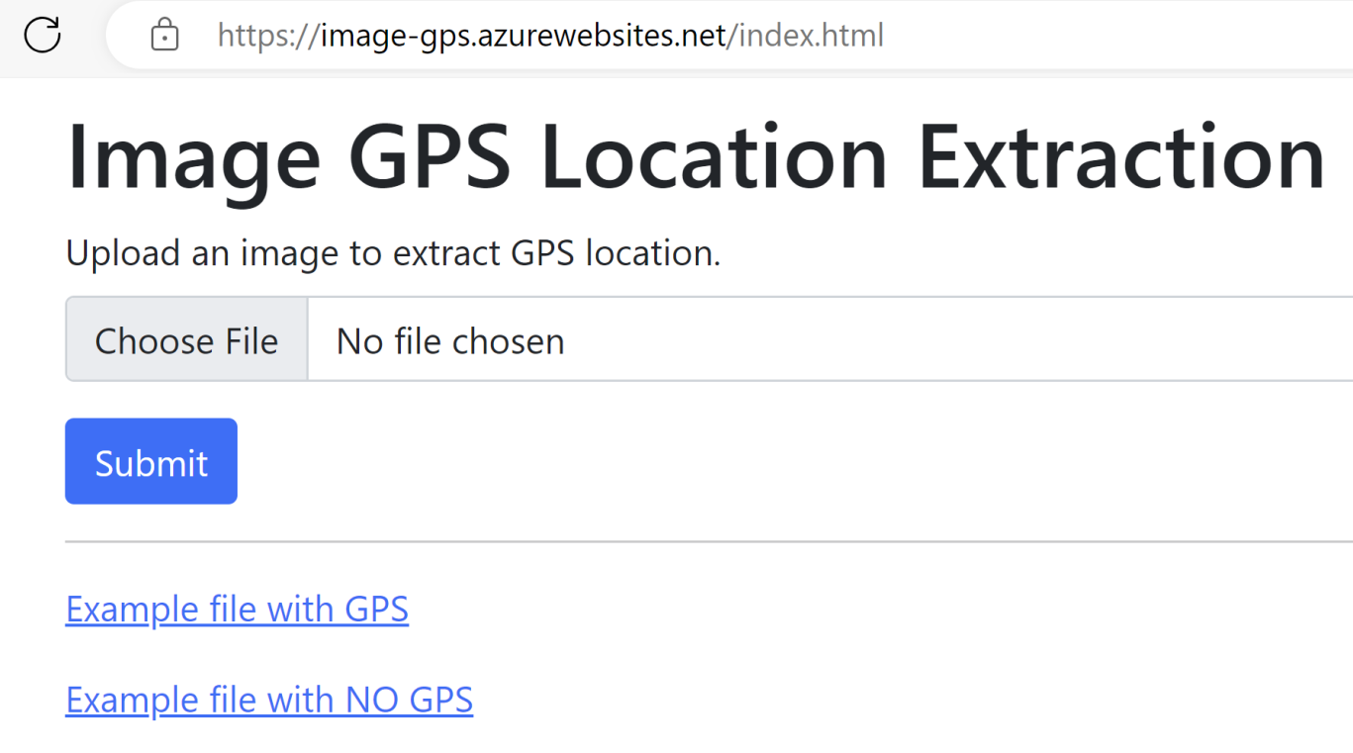
6. Open PHP Website
https://image-gps.azurewebsites.net/

Slide 11
7. Remove PHP Application
az group delete --name myResourceGroup

Slide 12


Slide 13
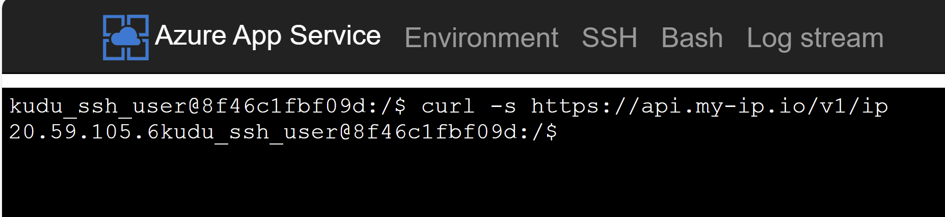
1. Open Debug Console
https://image-gps.scm.azurewebsites.net/DebugConsole
curl -s https://api.my-ip.io/v1/ip

Slide 14
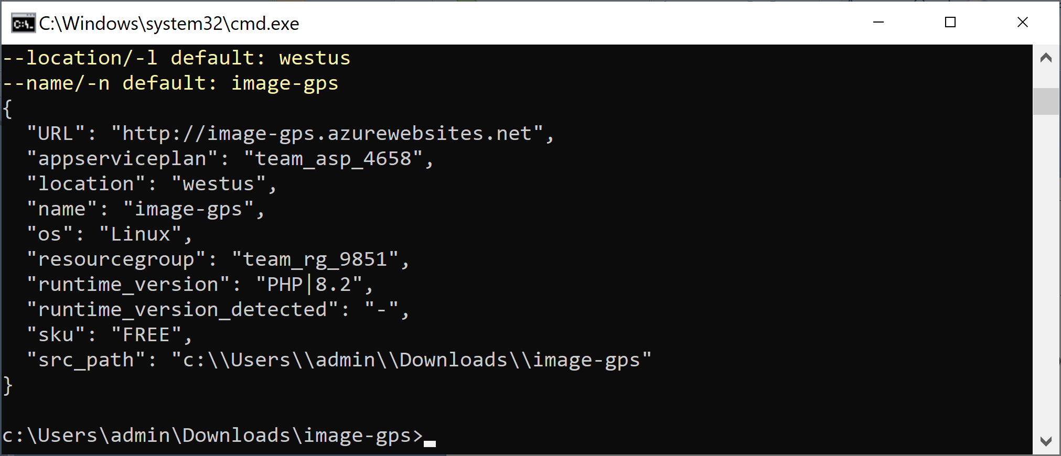
2. Update App on Azure
az webapp up --runtime "PHP:8.2" --os-type=linux --name "image-gps" --location "West US"

Slide 15

Thank You & See You Again

